Slide 1
Ezekiel 36-37
The hand of the LORD was upon me, and He brought me out by the Spirit of the LORD and set me down in the middle of the valley; and it was full of bones. (Ezekiel 37:1)

Slide 2
Ezekiel 36-37 Overview
God’s plan for restoring the people back to their land continues to unfold…
Restoration to the Land (36). Possibly the brightest chapter in the book of Ezekiel.
Rebirth of the nation (37). Depicted in a vision and a parable.

Slide 3
Ezekiel 36: Restoration to the Land
Redemption of the Land (36:1-7)
Repopulation of the Land (36:8-15)
Purification of the Land (36:16-38)
People judged (16-20)
God’s concern for His name (21-23)
Note the “I wills” of God (24-38)

Slide 4
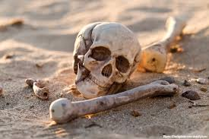
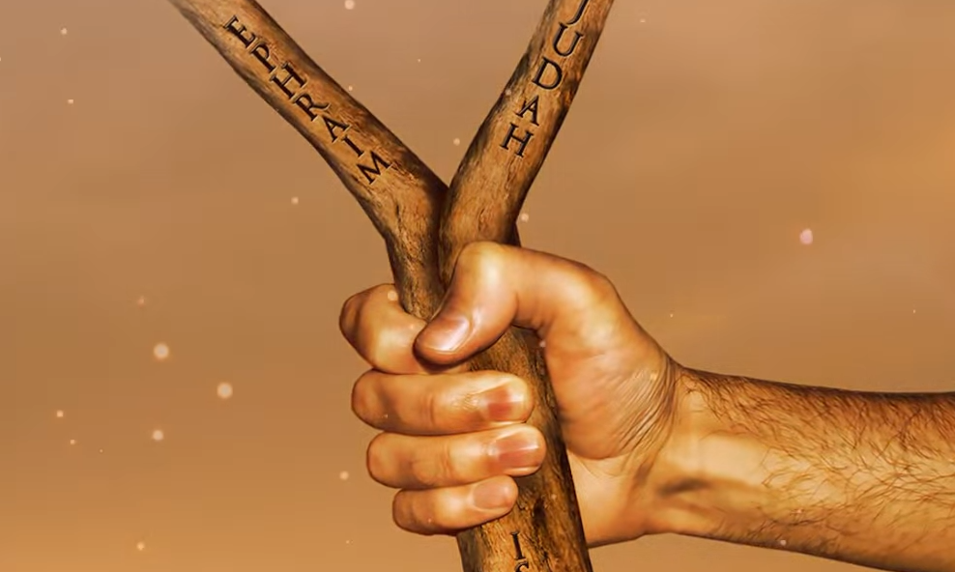
Ezekiel 37: Rebirth of the Nation
Vision of Dry Bones (37:1-14)
Parable of the Sticks (37:15-28)

Slide 5
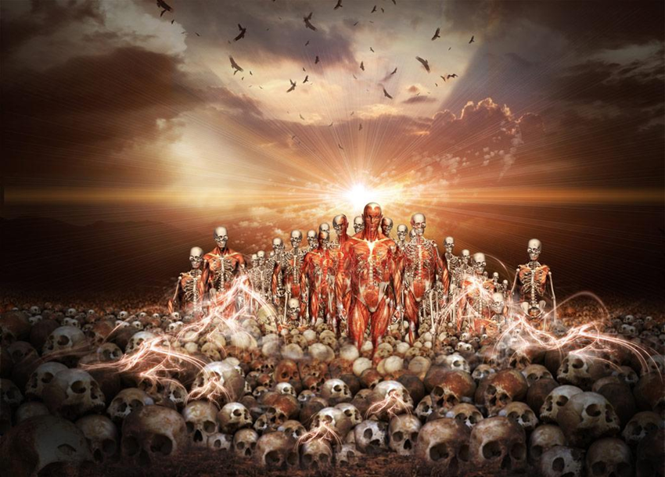
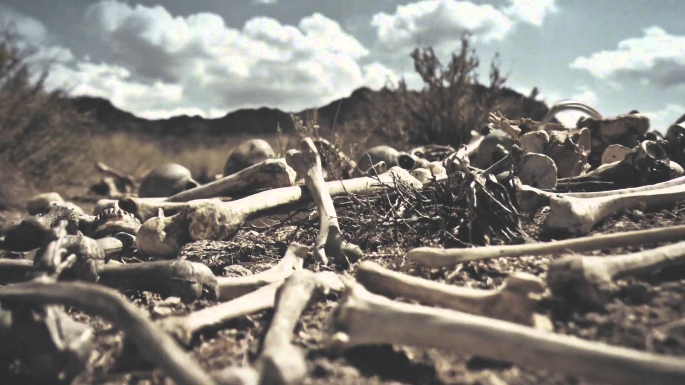
Ezekiel 37:1-14 Vision of Dry Bones
The Vision (1-10)
The Explanation (11-14)

Slide 6
Ezekiel 37:15-28 Parable of the Sticks
The Action Parable (15-17)
The Explanation (18-22)
“National Unity” (23-28)

